Slide 1

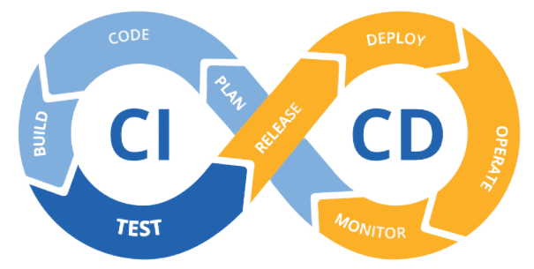





EPAM DevOps FINAL PROJECT (2021Q4)
Student: Taruraiev Oleksandr Oleksandrovich
CI/CD pipeline with VM, Jenkins, Terraform, Ansible, AWS

Slide 2

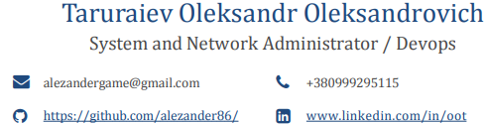
Information about the speaker
Summary: 13 years of experience in IT as a System Engineer (10yr.) and System Administrator (7yr.). Have experience in leading engineering teams and refining technical requirements with customers in the role of Product Owner. I also have a Computer Science degree.
I think, that the key to success in any business is a hard work and striving for be the best.
Education:
East Ukrainian National University 2008 - 2012 Master's degree: control and automation systems.
College of East Ukrainian National University 2004 -2008 Bachelor: Computer Programming and automated systems

Slide 3
Motivation of project
1.Try basic DevOps tools from lection material
2. Using the acquired knowledge to implement an autonomous pipeline and design it into a single project

Slide 4
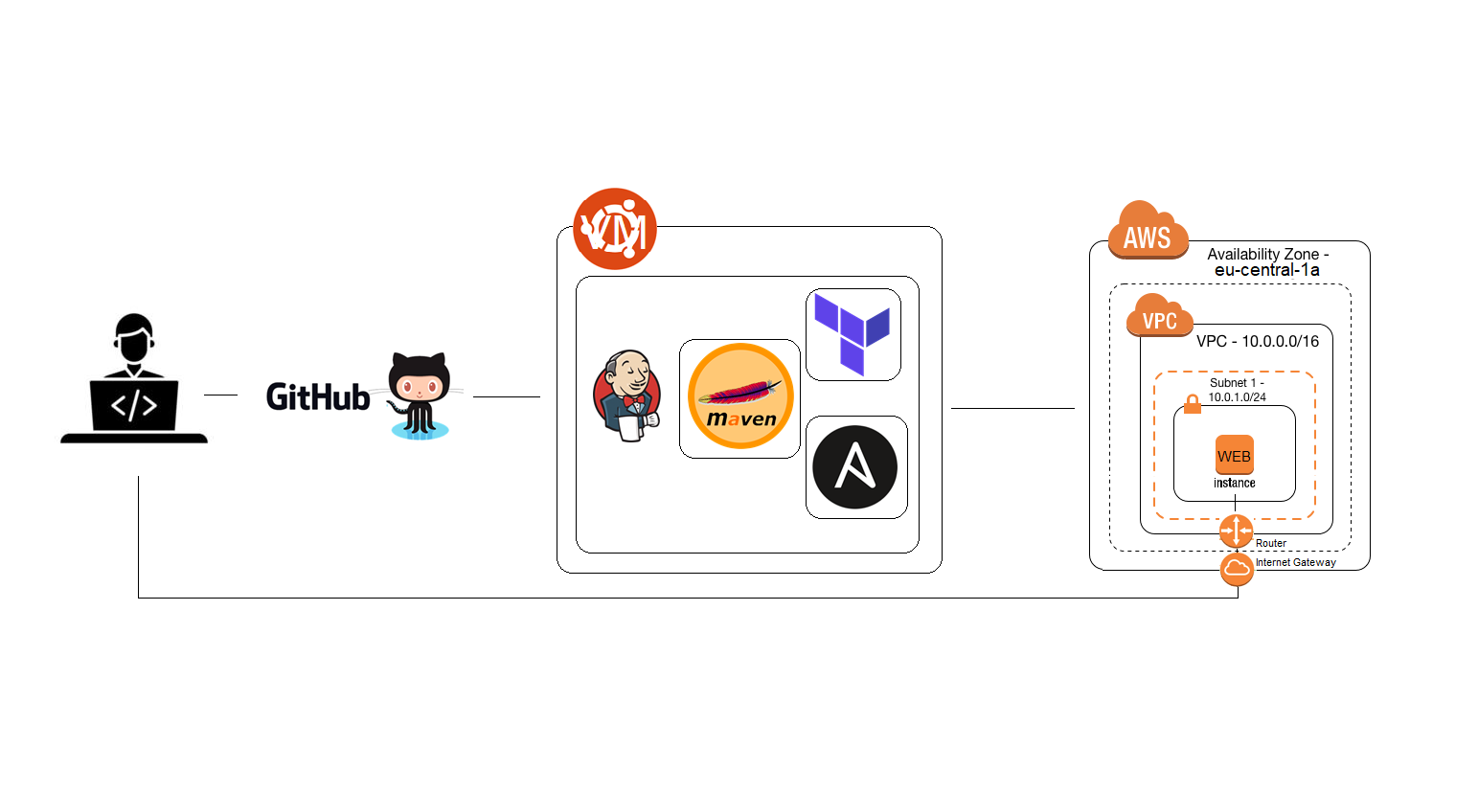
Pipeline scheme
Code pushed Github
GitHub update repo and knocking to Jenkins.
Jenkins based on preconfigured machine Oracle VM:
Jenkins download new code from GitHub
Jenkins tell the Maven to start testing and building the app.
Jenkins tell Terraform build new environment on AWS: VPC, Subnet, IG and install Ansible client on EC2.
Jenkins tell Ansible connect by ssh to AWS environment install java and copy the Maven-generated application.
In the end of pipeline Jenkins send notification by mail and telegram job status and IP of server

Slide 5
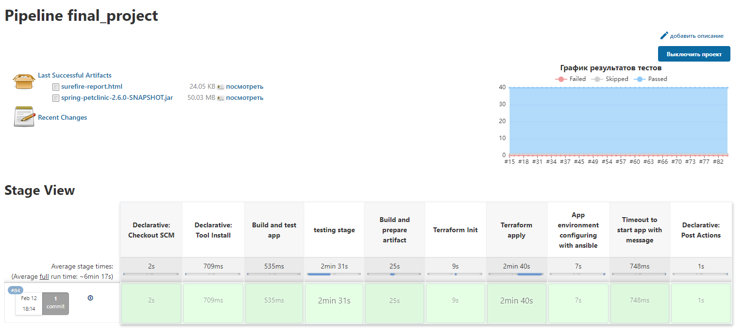
Project Stage view from Jenkins

Slide 6
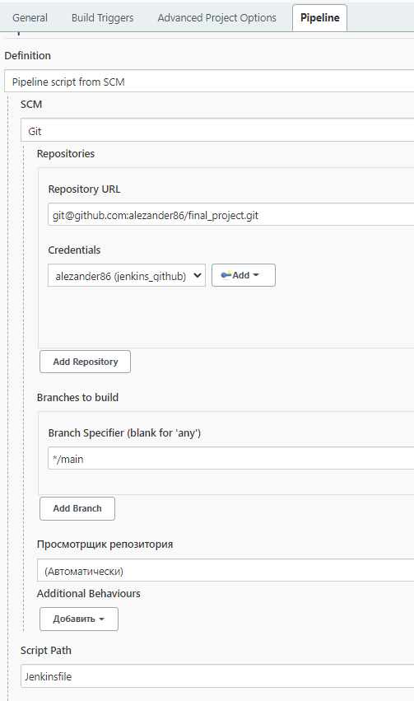
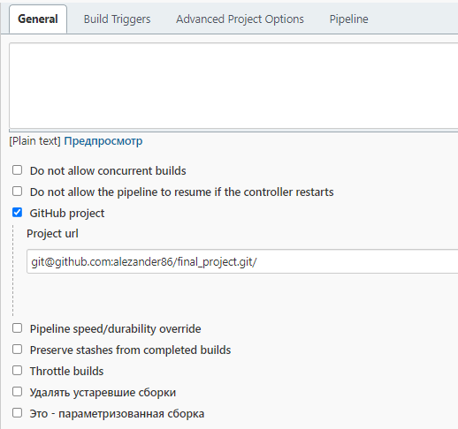
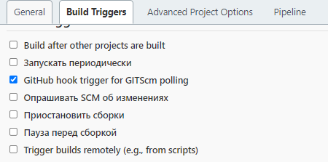
Jenkins project settings

Slide 7
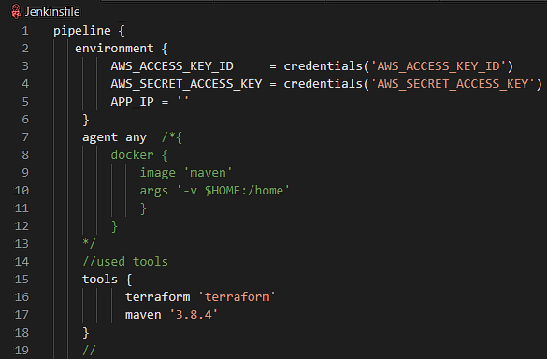
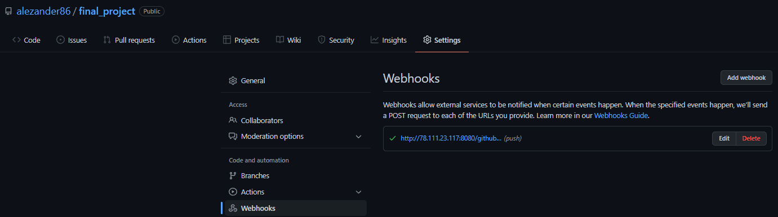
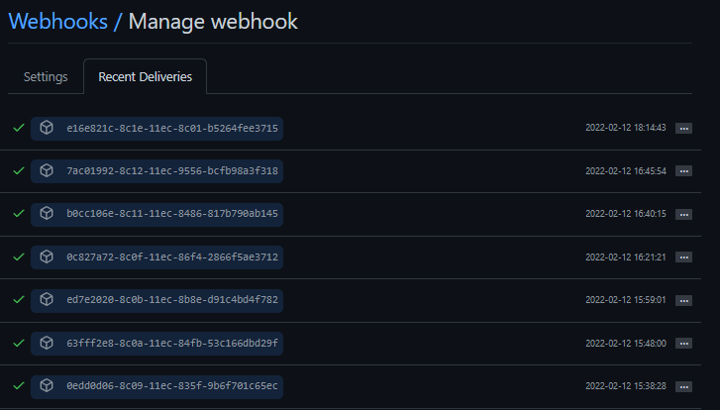
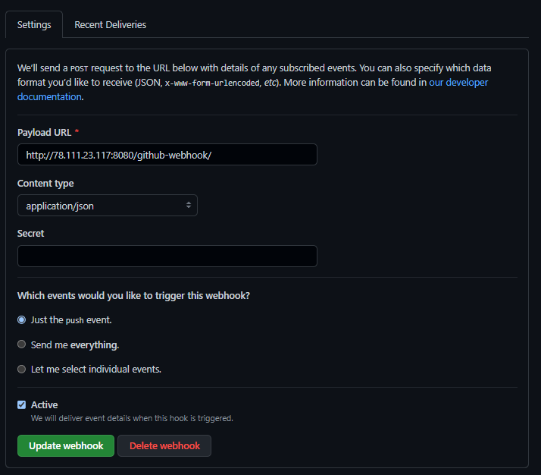
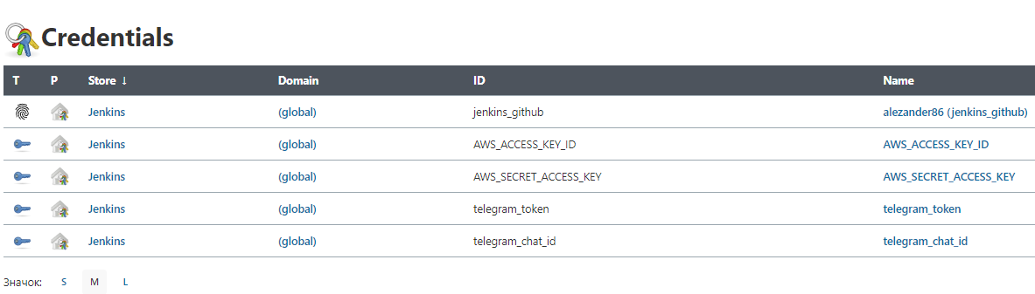
Jenkins credential, tools and GitHub hooks setting
Initially, the Docker image was responsible for building the application container. But this delayed the process and I this stage and commented. abandoned

Slide 8
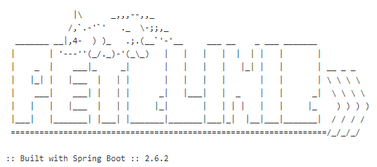
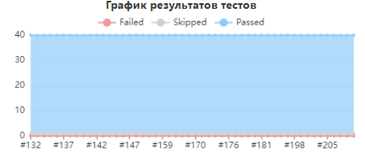
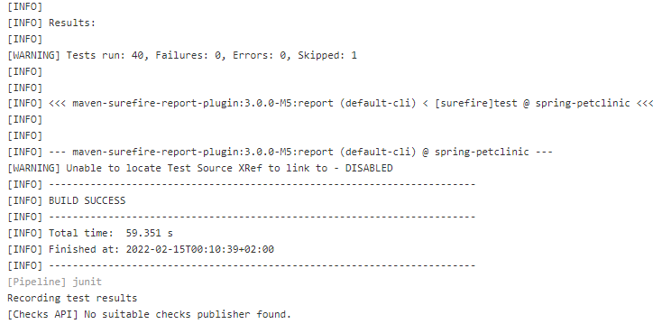
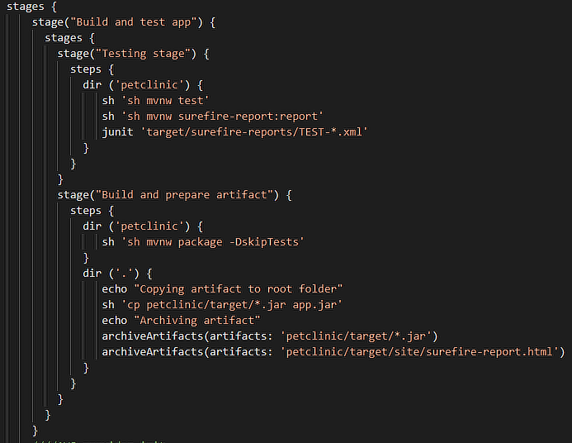
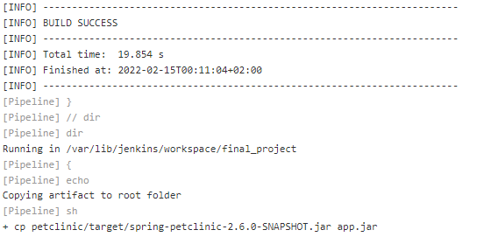
Maven
Testing stage
Build and prepare artifact

Slide 9
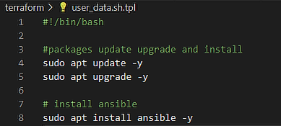
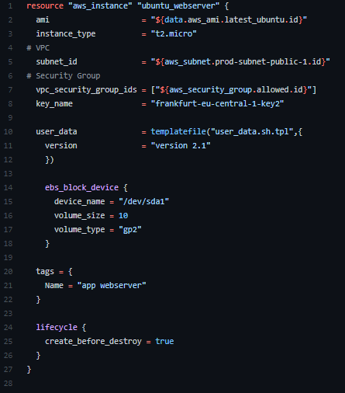
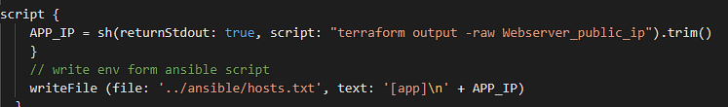
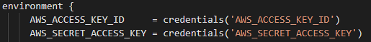
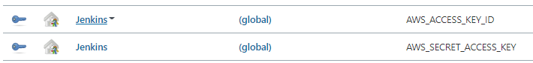
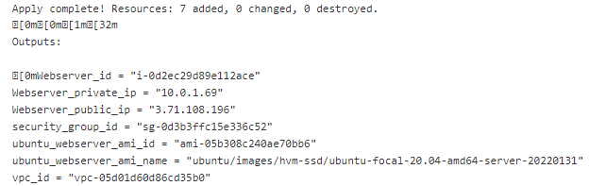
Terraform
Build instance
Take output with instance for host file
Install Ansible

Slide 10
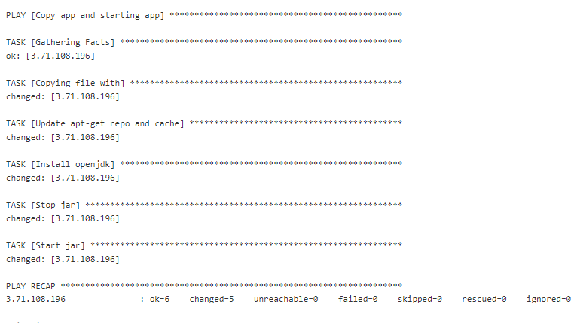
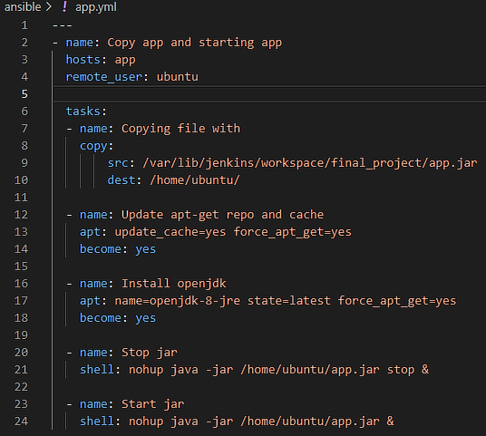
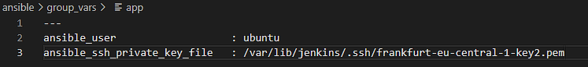
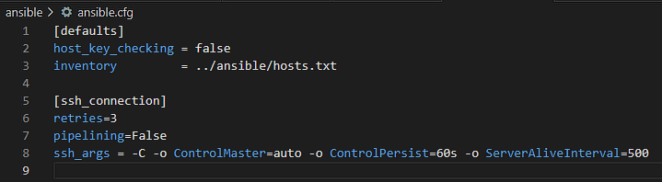
Ansible
Install Java
And run application

Slide 11
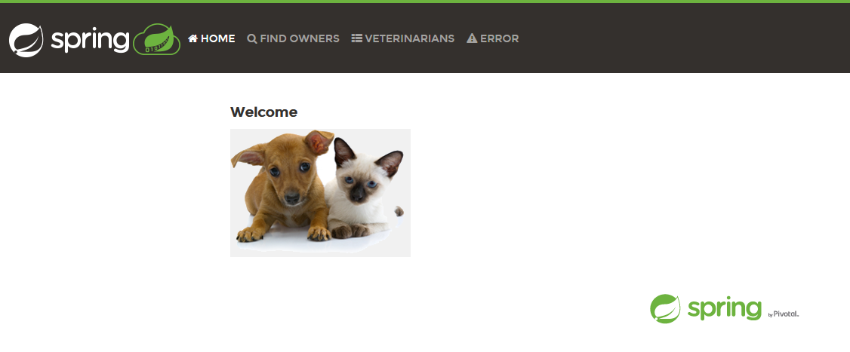
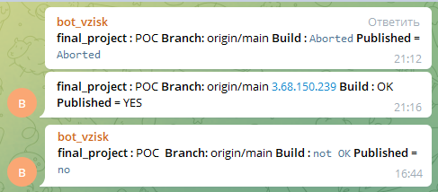
As Result we will receive notification and see application web page
Message output example
Thank you for your time and attention

